Slide 1
Persia
Imperial Policies and Culture
Religion

Slide 2
Persian Empire (550 B.C.E-580 C.E)
  Imperial Policies
    Achaemenid
      Darius and Xerxes
    Provinces
      Satrap
    “Royal Road”
    Ordinance of Good Relations
  Culture
    Farsi

Slide 3
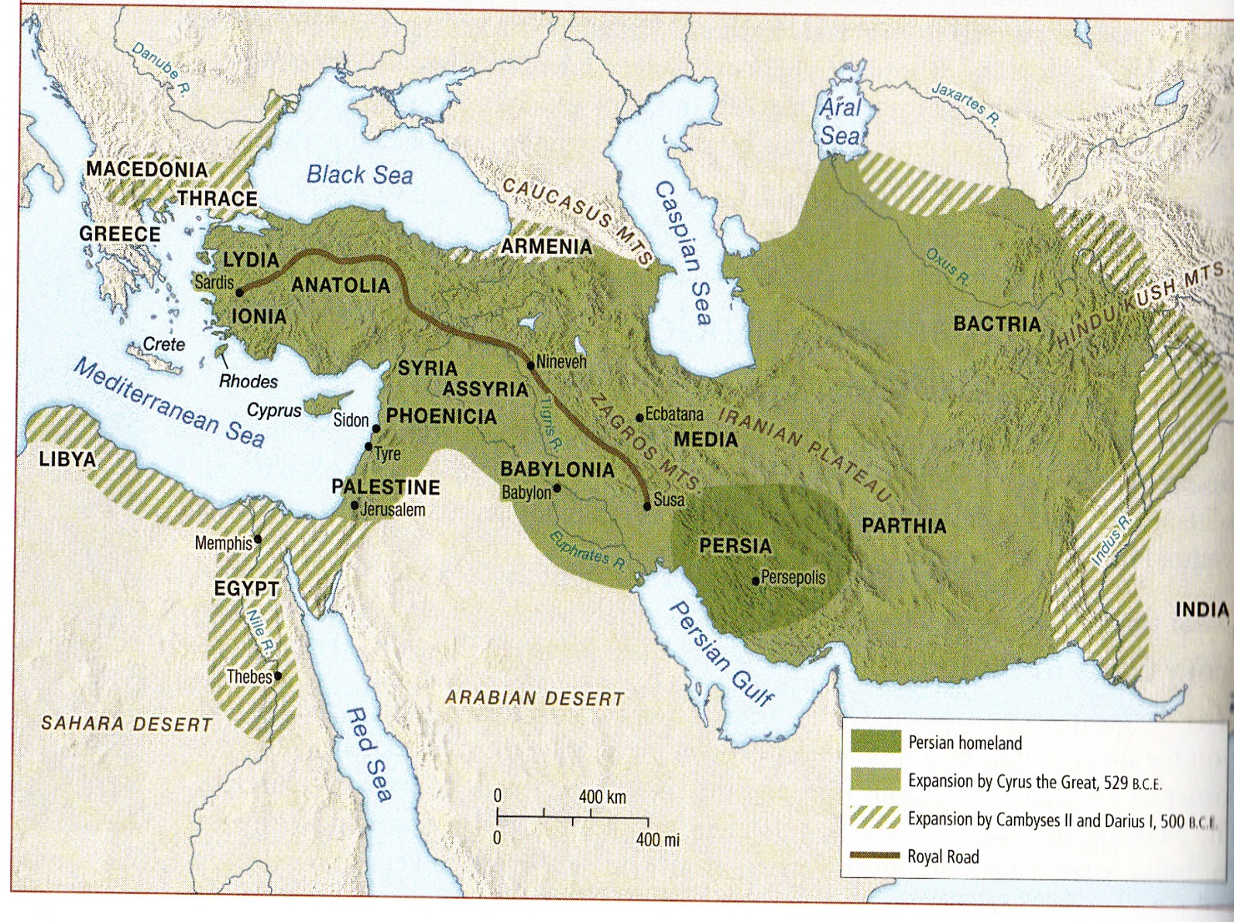

Slide 4
Religion
Zoroastrianism
  Prophet Zoroaster
  Avesta
    Ahura Mazda vs. Ahriman
    Magi
Concepts adapted by Judaism, Islam, Christianity.

